Slide 1
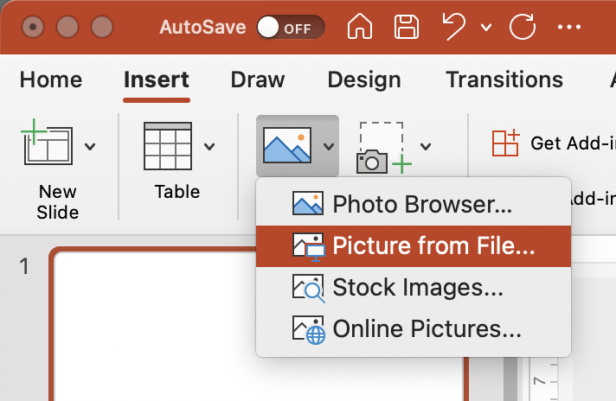
Library Lovers’ Day 2023
social media template
Adding text
Click the text “Your story…” on slide 3 and type in your text.
When finished, click outside of the box; such as the empty area around the slide.
Adding an image or logo to the template
Click on the Insert tab, then Pictures > Picture From File…
Locate your picture or logo and click Insert.
Arrange your image or logo within the frame on slide 3. The grey box is just an example that can be replaced and adjusted as you like.

Slide 2
Saving your image
Select everything on slide 3 by clicking and dragging over the whole slide, or press Ctrl+A.
Right click > Save as Picture…
Select JPEG From the file type drop down.
Choose a location to save and click Save.
Finished!
Log into your social media account and upload your image.

Slide 3
Your story…

